Slide 1
2024 Annual Outlook
The Fed: From Foe to Friend
<Enter Date>
--Rep Name
--Firm-Approved Title
--Registered Branch Address
--Approved Email and/or Registered Phone
--Securities Disclosure
Enter all information and submit to Ad Review for final approval
Notes:
Intro

Slide 2
Investment Themes
Three Themes in 2023 Market Outlook
Fed Goes From Foe to Friend
Economy Cooling into a Soft Landing
Market Volatility Will Provide Opportunities

Slide 3

Theme 1: Fed Goes From Foe to Friend
1
2
3
Fed has been a headwind to markets and economy.
Could Fed become a friend?
When will Fed cut rates?
Notes:
First theme is Fed goes from foe to friend. The Fed has been a headwind to markets and the economy, but could the Fed become a friend and cut rates in 2024?

Slide 4
End of the Rate Cycle?
Source: Cetera Investment Management, FactSet, Federal Reserve. Data as of 11/10/2023
Notes:
The Fed began raising rases in March of 2022. They raised rates aggressively and then tapered down the hikes until stopping hikes in July of 2023. While the Fed has not ruled out additional hikes it does appear they are done raising. The next question is when will they start cutting. If we see a recession, or if the Fed is comfortable with the path of inflation, it would happen even sooner.

Slide 5
Labor Supply and Demand Misalignment
Source: Cetera Investment Management, FactSet, U.S. Bureau of Labor Statistics. Data as of 9/30/2023.
Notes:
The Fed appears to have inflation under control now and that is partly due to a softening in the labor market. Wage inflation can be persistent, so the it has been a focus of the Fed. With the ratio of job openings to unemployed job seekers falling closer to pre-pandemic levels the Fed can gain comfort that the imbalances in the labor market are improving and possibly give them room to cut even without a recession.

Slide 6

Theme 2: Economy Cooling into a Soft Landing
Cooling inflation could be due to cooling economy, but economy appears resilient.
Notes:
The second theme only helps the Fed more. A cooling economy means cooling inflation most of the time.

Slide 7
Aging Population
Source: Cetera Investment Management, Federal Reserve Bank of St. Louis, U.S. Bureau of Labor Statistics. Data as of 9/30/2023.
Notes:
If the economy does cool into a recession we think it could be mild though. While the labor imbalance is improving, there are still more job openings than people looking for work. We think as long as people are employed they will spend money and let’s not forget this is a consumer driven economy. With baby boomers retiring, those jobs need to be filled.
The baby boomers are hitting retirement at an increasing rate. From January 2000 to September 2023 the population of people over 55 years old increased by 75%, or 42.8 million. Over that same period the population of 25–54-year-olds (prime-age workforce) only increased by 6.5%, or 7.8 million. This has many implications, especially for the labor market. With help wanted signs seemingly everywhere and more job openings than people looking for work, one might question where all the workers went. In part, they retired. This disparity creates a problem that won’t go away anytime soon, and slowing population growth is bad news for economic growth. This is not just a problem for the U.S., but for most developed countries. The good news is that with challenges come opportunities.

Slide 8
Construction Spending Surge for New Manufacturing Plants
Source: Cetera Investment Management, FactSet, U.S. Census Bureau. Data as of 9/30/2023.
Notes:
The aging population could also serve to lower long-term bond yields as this demographic shifts from stocks to bonds for stable income and safety. Lower bond yields are a catalyst for growth, not to mention good for bond prices and thus bond returns.
The U.S. may also be able to capitalize on cheaper energy prices and its ability to be energy independent with its abundance of cheap natural gas. With energy prices in Europe rising, it’s cheaper to manufacture in the U.S., which also carries the benefit of its large customer base and resultant reduced costs, as having manufacturing closer to potential customers saves on transportation. With the world more conscious about carbon emissions, it could be advantageous to manufacture goods in North America. Add to that the fact that carbon emissions are a global problem, exporting pollution to other countries with lower emissions standards may eventually gain scrutiny. We are already seeing the groundwork for another domestic manufacturing boom, with construction spending on manufacturing facilities in the U.S. more than doubling since the start of 2022. Investments in domestic semiconductor and battery plants are key drivers of the boom.

Slide 9

Theme 3. Market Volatility Will Provide Opportunities
Volatility could mean more opportunities.
Notes:
Finally, the third theme is more volatility, which could mean more opportunities.

Slide 10
Long-Term Perspective on Valuations
Source: Cetera Investment Management, YCharts, S&P Global. Data as of 9/30/2023.
Notes:
Since we are considering longer-term themes, let’s look at longer-term valuation metrics. A key theme is the cyclically adjusted price-to-earnings ratio (CAPE ratio) otherwise known as the Shiller P/E ratio because it was popularized by renowned Yale University professor Robert Shiller. This ratio factors in that companies do better or worse during different parts of the economic cycle and looks to smooth those effects. It measures the share price relative to average earnings per share over a 10-year period adjusted for inflation. As you can see here, the CAPE ratio is high relative to its long-term average. While the average since 1950 is 20.2, the ratio peaked in December of 1999 at 44.2. It was 30.8 as of 9/30/2023. Based on this long-term ratio meant to account for earnings during different economic cycles, it appears that the S&P 500 is over-valued relative to its earnings. The high P/E for the index is driven mainly by the growing size of large growth companies in the index.

Slide 11
Valuation Gap
Source: Cetera Investment Management, FactSet, S&P Global. Data as of 10/31/2023.
Notes:
While stock prices appear to be rich for large growth companies and there appears to be better value out there in other areas of the market, earnings are expected to improve. After three consecutive quarters of it being negative, earnings growth turned positive for the S&P 500 in the third quarter of 2023. Looking to 2024, earnings growth is expected to be near 12% according to FactSet. If inflation moderates more than expected, we could see even better earnings as input costs of companies decline. Small cap stocks seem very undervalued relative to historical P/E ratios.

Slide 12
Volatility Isn’t Always a Bad Thing
Source: Cetera Investment Management, FactSet, YCharts. The annual total return includes dividends. The annual max decline is the largest price decline in each calendar year. Return and max drawdown data based on closing prices. Data as of 12/31/2022.
Notes:
Stock market corrections can create better entry points as well. There is a lot of cash on the sidelines currently, so a lot of investors may be looking to enter the market. Here you can see the intra-year draw downs represented by light blue dots. Even in years with large drawdowns you can see positive returns in many of those years. Since 1980, the average annual max drawdown is 14.3% yet the average annual total return for a year is 12.9%.

Slide 13
Real Interest Rates
Source: Cetera Investment Management, Federal Reserve Bank of St. Louis, Federal Reserve Bank of Cleveland. Data as of 10/31/2023.
Notes:
In 2024, inflation will likely be close to the Fed’s expectations for around 2.5%. Bond yields have been volatile, but for the sake of simplicity assuming the 10-year Treasury yield is 5%, that would mean an inflation adjusted return (known as a real return) of around 2.5%. This is the first year investors with 10-Year Treasury bonds have seen real returns over 2% since before the Great Financial Crisis. Returns haven’t been over 2.5% in over 20-years. Real yields were even negative for much of 2020 and 2021. So even if these higher yields persist, that could be good for bond investors if inflation projections are correct. And if bond yields fall with inflation and lower this real return, like we mentioned before, it’s still good for bond holders because that means bonds will appreciate in price.

Slide 14
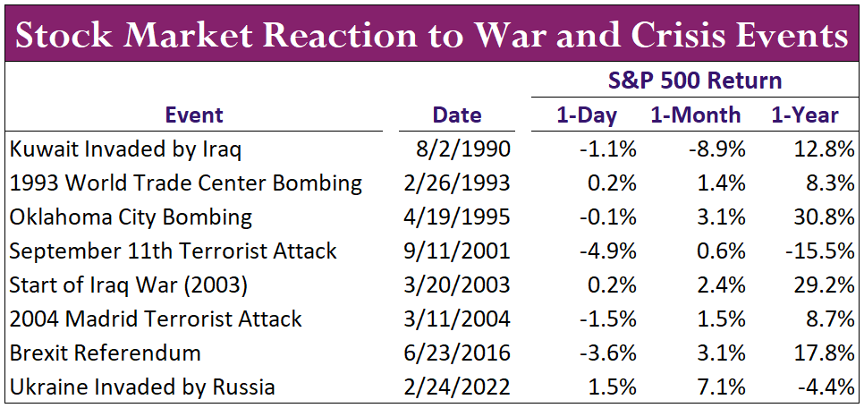
Market Impact from Geopolitical Crisis is Often Short-lived
Source: Cetera Investment Management, FactSet, Standard & Poor's. Returns shown are total returns, which include dividends.
Notes:
Geopolitical risk, like the uncertainties around the wars in the Middle East and Ukraine, might escalate, or new conflicts could arise elsewhere. Such hostilities are hard to predict and can turn markets quickly. These geopolitical events tend not to be long-term headwinds for markets though and typically only provide short-term volatility. You can see here that a month or year after the event, the market is usually positive and there are larger forces at play. For instance, markets were largely down a year after the 9/11 terrorist attacks because of the dot com bubble, not 9/11.

Slide 15
Thank You!
Follow Us:
@CeteraIM
Notes:
Risks remain in the economy and markets, but in many areas the economic data is improving off its lows. Inflation is moderating and expected to be around 2.5% next year, which should give room for the Fed to reverse its interest rate policies and cut rates. If the Fed cuts rates more than expected, it could serve as a tailwind to both bonds and stocks.
Diversification may come back into favor in 2024. Large cap growth stocks have carried the market for much of 2023, but other stocks may shine if earnings growth comes in as many anticipate next year. With bonds finally paying a real return (after adjusted for inflation), they could provide solid diversification for any equity volatility. Being an election year with a lot of geopolitical headwinds and a Fed possibly transitioning its monetary policy to be less restrictive, there will likely be volatility along the way.
No matter what 2024 has in store, we can help you through any uncertainty and help keep you focused on your personal goals and objectives.

Slide 16
Disclosures
About Cetera® Financial Group
Cetera Financial Group” refers to the network of independent retail firms encompassing, among others, Cetera Advisors LLC, Cetera Advisor Networks LLC, Cetera Investment Services LLC (marketed as Cetera Financial Institutions or Cetera Investors), and Cetera Financial Specialists LLC. All firms are members FINRA/SIPC. Located at 655 W. Broadway, 11th Floor, San Diego, CA 92101.
Individuals affiliated with Cetera firms are either Registered Representatives who offer only brokerage services and receive transaction-based compensation (commissions), Investment Adviser Representatives who offer only investment advisory services and receive fees based on assets, or both Registered Representatives and Investment Adviser Representatives, who can offer both types of services.
About Cetera® Investment Management
Cetera Investment Management LLC is an SEC registered investment adviser owned by Cetera Financial Group®. Cetera Investment Management provides market perspectives, portfolio guidance, model management, and other investment advice to its affiliated broker-dealers, dually registered broker-dealers and registered investment advisers.
For more information about Cetera Investment Management, please reference the Cetera Investment Management LLC Form ADV disclosure brochure and the disclosure brochure for the registered investment adviser your adviser is registered with. Please consult with your adviser for his or her specific firm registrations and programs available.
No independent analysis has been performed and the material should not be construed as investment advice. Investment decisions should not be based on this material since the information contained here is a singular update, and prudent investment decisions require the analysis of a much broader collection of facts and context. All information is believed to be from reliable sources; however, we make no representation as to its completeness or accuracy. The opinions expressed are as of the date published and may change without notice. Any forward-looking statements are based on assumptions, may not materialize, and are subject to revision.
All economic and performance information is historical and not indicative of future results. The market indices discussed are not actively managed. Investors cannot directly invest in unmanaged indices. Please consult your financial advisor for more information.
Additional risks are associated with international investing, such as currency fluctuations, political and economic instability, and differences in accounting standards.
A diversified portfolio does not assure a profit or protect against loss in a declining market.

Slide 17
Glossary
The S&P 500 is an index of 505 stocks chosen for market size, liquidity and industry grouping (among other factors) designed to be a leading indicator of U.S. equities and is meant to reflect the risk/return characteristics of the large cap universe.
The Russell 1000 Growth Index measures the performance of the large-cap growth segment of the U.S. equity universe. It includes those Russell 1000 Index companies with higher price-to-book ratios and higher forecasted growth values.
The Russell 1000 Value Index measures the performance of the large-cap value segment of the U.S. equity universe. It includes those Russell 1000 Index companies with lower price-to-book ratios and lower forecasted growth values.
The Chicago Board Options Exchange (CBOE) Volatility Index, commonly known by its ticker symbol VIX, is a measure of the stock market's expectation of volatility implied by S&P 500 index options.
The Bloomberg Barclays US Aggregate Bond Index is a broad based flagship benchmark that measures the investment grade, US dollar-denominated, fixed-rate taxable bond market. Eligible bonds must have at least one year until final maturity, but the index holdings have a fluctuating average life of around 8.25 years. This total return index is unhedged and rebalances monthly.
The ICE BofA US High Yield Index tracks the performance of US dollar denominated below investment grade rated corporate debt publicly issued in the U.S. domestic market. To qualify for inclusion in the index, securities must have a below investment grade rating (based on an average of Moody's, S&P, and Fitch) and an investment grade rated country of risk (based on an average of Moody's, S&P, and Fitch foreign currency long term sovereign debt ratings). Each security must have greater than 1 year of remaining maturity, a fixed coupon schedule, and a minimum amount outstanding of $100 million.
The Nasdaq Composite Index is a large, broad-based, market-cap-weighted index of more than 2,500 common equities listed on the Nasdaq stock exchange. It is often seen as a stand-in for the technology sector and its performance.

